Slide 1
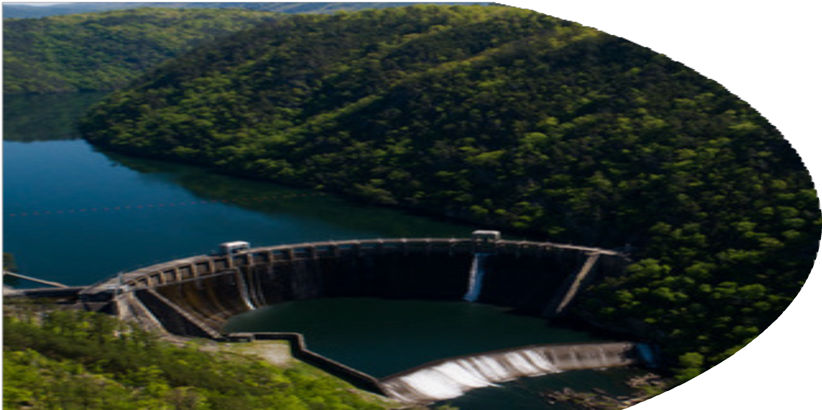
Q4 CEO REPORT
NHA Board of Directors Meeting San Diego, CA
December 12, 2023

Slide 2
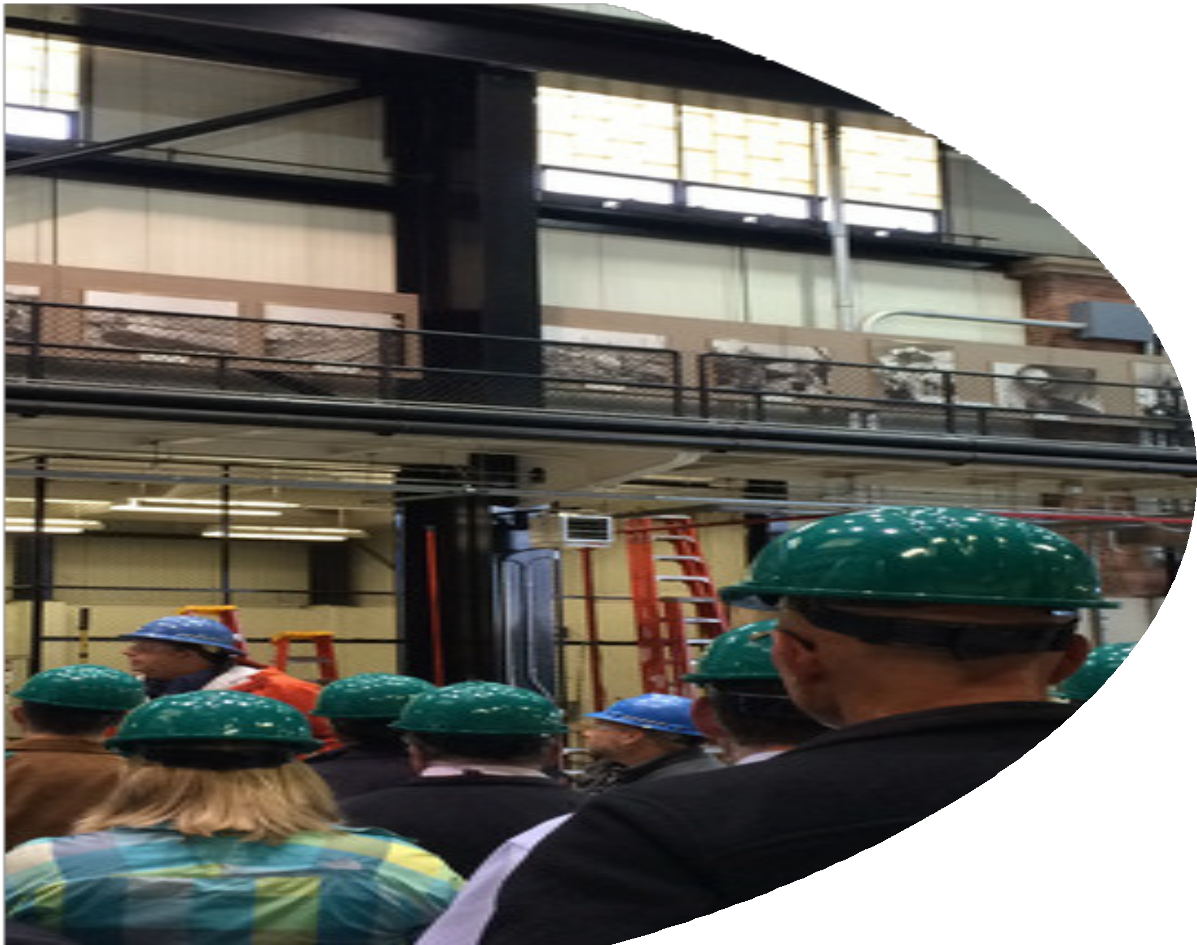
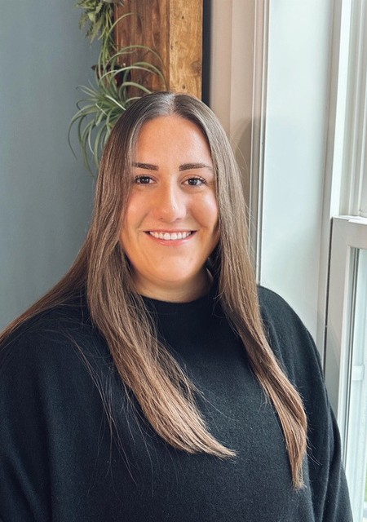
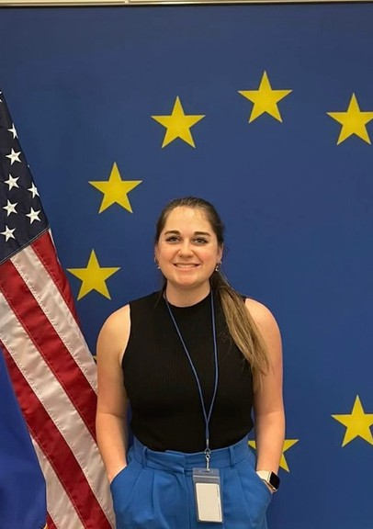
Ellie Rubalow Events Specialist
Connor Nelson Sydney Rovner Regulatory and Market Program Assistant
Affairs Specialist

Slide 3
ADVOCATE
INFORM
members, the industry, policy makers, and stakeholders about timely industry-related policy and technical developments and how those developments will affect the industry; and the many public benefits provided by waterpower.
IMPLEMENT
internal operational practices for the association that will ensure a high-performing, effective organization.
to preserve, enhance, and expand the use of waterpower generation to advance a 21st century clean energy grid.
CONNECT
member organizations and their employees with other waterpower professionals to build relationships, exchange knowledge, and facilitate business.

Slide 4
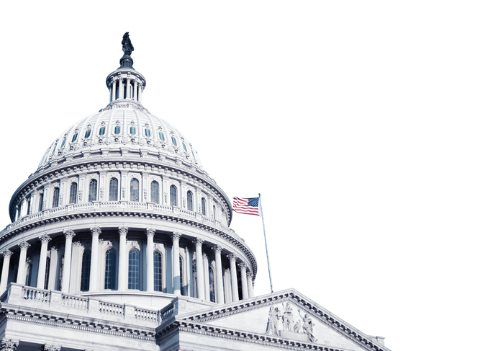
2023 NHA PRIORITY ACTIONS- PROGRESS REPORT
Progress NHA has achieved to date towards:
Streamlining Licensing and Relicensing
Creating Tax Support to Preserve Existing Hydropower
Investing in Waterpower RD&D
Effective Implementation of BIL and IRA
Retrofitting Non-Powered Dams
Valuing Reliability Services in Wholesale Electricity Market Design
Avoiding Unnecessary Regulatory Barriers

Slide 5
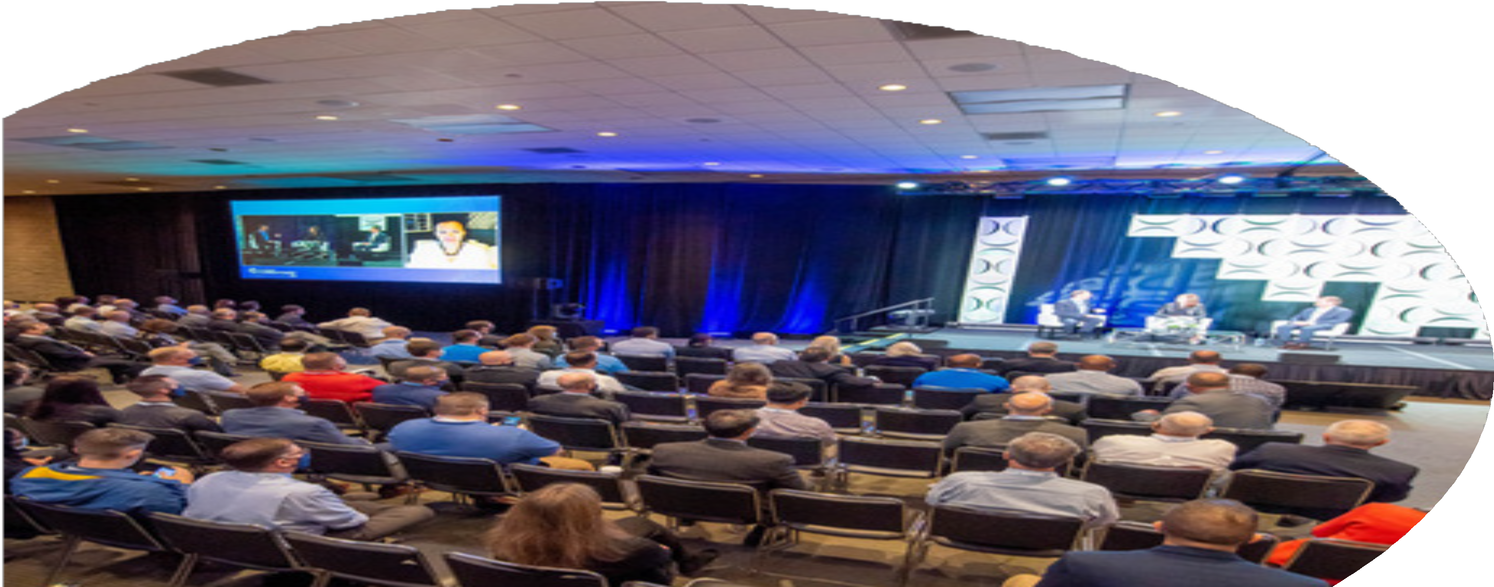
2023 NHA Priority Actions - Progress Report
Progress NHA has achieved to date towards:
Attracting Asset Owners
Using WPW to Enhance NHA’s Advocacy Efforts
Promoting DEI at All NHA Events

Slide 6
2023 NHA Priority actions - Progress Report
Progress NHA has achieved to date towards:
Expanding NHA’s Social Media Engagement
Reaching 1M+ Millennials

Slide 7
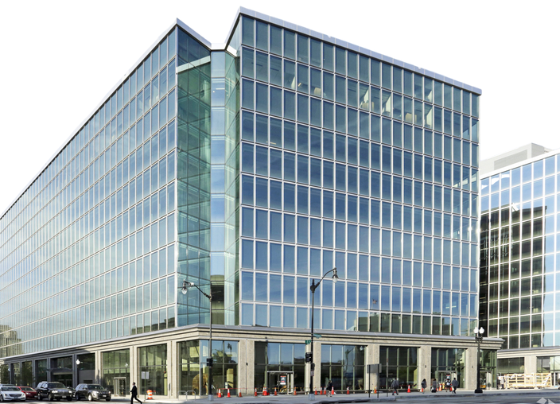
2023 NHA Priority Actions - Progress Report
Progress NHA has achieved to date towards:
Deepening Member Engagement
Executing Office Relocation with Minimal Disruptions Retaining NHA Staff

Slide 8
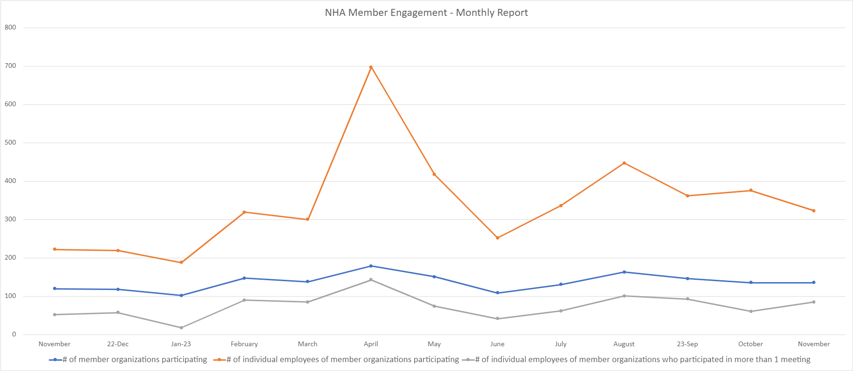
Over 33% Increase in
Average # Participating in Committee / Council Meetings (comparing 2022 monthly average (273) to 2023 to date (365))
Participation in committee and council meetings

Slide 9
Questions?

