Slide 1
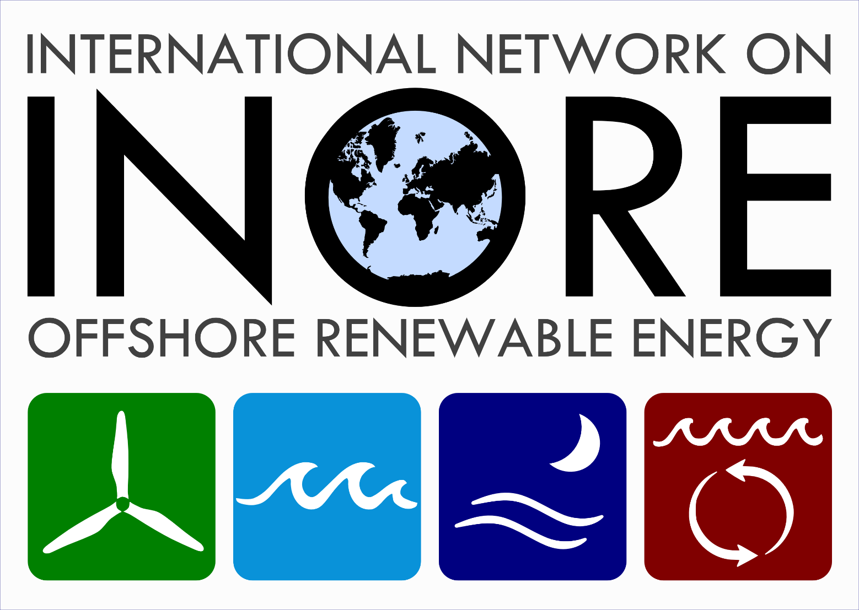
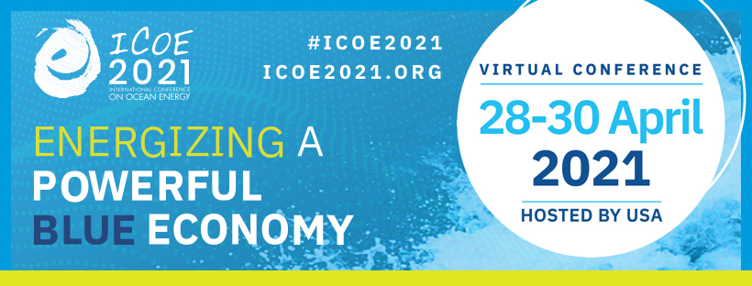
Emerging Global Trend Impacts
on MHK Discussion
Wednesday, 28 April 2021 (10:00-10:45 am EST)
Four panelists representing government, national lab, industry and academia will discuss the emerging global trend impacts on MHK. Please join us for a discussion about how global health, political, and economic trends are impacting MHK industries.
How to join?
Please fill in the form for pre-registration by clicking the link (registration is free).
Registration link: https://virginiatech.zoom.us/webinar/register/WN_4yAdqkx_QUCKcdA9daHQ-g
What is INORE?
We are an association of graduate students and early-stage researchers working on topics related to offshore renewable energy. INORE has more than 1000 members from over 70 countries. Our mission is to:
Bring together a diverse group of early-stage researchers (INOREans) from around the world;
Promote the study of offshore renewable energy;
Support the endeavors of our members;
Build friendships, foster collaboration, and share knowledge within INORE and throughout the world.
More information:
INORE : https://inorean.org/about-us_new/
ICOE 2021: https://icoe2021.org/
For more information: jiami@vt.edu

